Slide 1
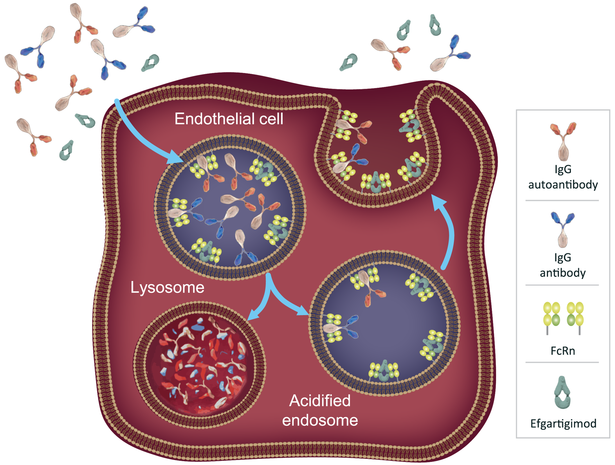
Overview of Clinical Trials With Efgartigimod in Autoimmune Blistering Diseases: Pemphigus Vulgaris and Pemphigus Foliaceus (ADDRESS and ADDRESS+) and Bullous Pemphigoid (BALLAD and BALLAD+)
Snejina Vassileva,¹ Dedee F. Murrell,² Donna A. Culton,³ Hideyuki Ujiie,⁴ Michael Hertl,⁵ Matthias Goebeler,⁶ Animesh A. Sinha,⁷ Enno Schmidt,⁸ Ivaylo Stoykov,⁹ Peter Verheesen,⁹ Luca Borradori,¹⁰ Victoria P. Werth,¹¹ Pascal Joly¹²
¹Medical University – Sofia, Sofia, Bulgaria; ²St George Hospital and University of New South Wales, Sydney, Australia; ³University of North Carolina School of Medicine, Chapel Hill, NC, USA; ⁴Hokkaido University, Sapporo, Japan; ⁵Philipps-Universität Marburg, Marburg, Germany; ⁶University Hospital Würzburg, Würzburg, Germany; ⁷Jacobs School of Medicine and Biomedical Sciences, University at Buffalo, Buffalo, NY, USA; ⁸University of Lubeck, Lubeck, Germany; ⁹argenx, Ghent, Belgium; ¹⁰University Hospital Inselspital, Bern, University of Bern, Bern, Switzerland; ¹¹University of Pennsylvania and Corporal Michael J. Crescenz VAMC, Philadelphia, PA, USA; ¹²Rouen University Hospital, Rouen, France
BACKGROUND
RESULTS
KEY TAKEAWAYS
Efgartigimod: Engineered IgG1 Fc Fragment^{1–5}
The neonatal Fc receptor, FcRn, recycles immunoglobulin G (IgG), extending its half-life and serum concentration¹
Efgartigimod is a human IgG1 Fc fragment, a natural ligand of FcRn, engineered for increased affinity for FcRn²
Efgartigimod was designed to outcompete endogenous IgG, preventing recycling and promoting lysosomal degradation of IgG, without impacting its production^{2–5}
Targeted reduction of all IgG subtypes
No impact on IgM or IgA
No reduction in albumin or increase in cholesterol levels
Pemphigus and Bullous Pemphigoid: IgG-Mediated Autoimmune Diseases^{6–9}
Pemphigus vulgaris (PV) and pemphigus foliaceus (PF) are debilitating and potentially life-threatening autoimmune blistering diseases that are associated with mucosal erosions (PV) and/or cutaneous blisters (PV and PF)
PV is characterized by pathogenic IgG autoantibodies targeting desmosomal proteins, desmoglein 3 (Dsg-3), and, in 50% of the cases, desmoglein 1 (Dsg-1); PF is caused by autoantibodies against Dsg-1
Bullous pemphigoid (BP) is one of the most common autoimmune subepidermal blistering diseases of the skin and has high morbidity
BP is mediated by IgG and IgE autoantibodies against BP180 (BPAG2, type XVII collagen) and BP230 (BPAG1e), 2 components of the dermal-epidermal junction
These autoantibodies are pathogenic by impairing keratinocyte adhesion and by triggering an inflammatory cascade, directly impairing dermal-epidermal adhesion in pemphigus and BP, respectively
Autoantibody titers correlate significantly (Dsg-3 and Dsg-1) and partially (BP180) with disease severity
Current therapies are frequently associated with suboptimal effectiveness, slow onset of action, increased risk of serious adverse events, or patient inconvenience, which may create challenges in treatment
Efgartigimod Is Clinically Effective and Well Tolerated in Phase 2 and 3 Trials in IgG-Mediated Disorders^{4,10–13}
222 participants with pemphigus have enrolled into the ADDRESS trial as of February 28, 2023
Readout is expected in late 2023
Phase 3 ADAPT for gMG |  | Phase 3 ADAPT+ OLE for gMG | Phase 3 ADVANCE IV for Primary ITP |  | Phase 2 Pemphigus Open-Label
AChR-Ab+ EFG 10 mg/kg IV (n=65) | AChR-Ab+ Placebo IV (n=64) | EFG 10 mg/kg IV (N=145) | EFG 10 mg/kg IV (n=86) | Placebo IV (n=45) | EFG 10–25 mg/kg IV (N=34)
MG-ADL responders in cycle 1 |  | Mean (SE) change from baseline in MG-ADL score in cycle 1 at Week 3 (AChR-Ab+ n=111) | Sustained platelet count* response in chronic ITP |  | DC†: 90% Median time (range) to DC: 17 (6–92) days
67.7% (44/65) | 29.7% (19/64) | –5.0 (0.33) | 21.8% (17/78) | 5.0% (2/40)
Odds ratio = 4.951 (95% CI: 2.213–11.528); P<.0001 |  |  | Odds ratio = 4.884 (95% CI: 1.007–43.591) Adjusted difference in response‡ = 15.9% (95% CI: 2.6–26.4)
QMG responders in cycle 1 |  | Mean (SE) change from baseline in MG-ADL score in cycle 1 at Week 3 (overall N=145) |  |  | CR§: 64% Median time (range) to CR: 92 (13–287) days
63.1% (41/65) | 14.1% (9/64) | –5.1 (0.31)
Odds ratio = 10.842 (95% CI: 4.179–31.200); P<.0001
FcRn, neonatal Fc receptor; IgG immunoglobulin G. Image adapted from Kang TH, Jung ST. Boosting therapeutic potency of antibodies by taming Fc domain functions. Exp Mol Med. 2019;51:1–9 and distributed under the terms of the Creative Commons CC-BY license (https://creativecommons.org/licenses/by/4.0/).
Worldwide recruitment is now ongoing for BALLAD
AChR-Ab, acetylcholine receptor antibody; CR, complete remission; DC, disease control; EFG, efgartigimod; gMG, generalized myasthenia gravis; ITP, immune thrombocytopenia; IV, intravenous; MG-ADL, Myasthenia Gravis Activities of Daily Living; OLE, open-label extension; QMG, quantitative myasthenia gravis; SE, standard error. *Defined as the proportion of participants in the chronic population achieving platelet counts of ≥50×10⁹/L for ≥4 of 6 visits between Weeks 19 and 24 of the study. †No new lesions and established lesions starting to heal; time to end of consolidation. ‡Based on Cochran-Mantel-Haenszel statistic stratified for splenectomy, receipt of concurrent ITP therapies at baseline, and baseline platelet count level category (<15×10⁹/L vs ≥15×10⁹/L). §Absence of new lesions and established lesions completely healed by international consensus.
Efgartigimod was well tolerated and demonstrated a consistent safety profile across varying dosing regimens (cyclical in generalized myasthenia gravis [gMG]; continuous in immune thrombocytopenia and pemphigus) and exposure times (up to 229.0 patient-years in ADAPT+)
Efgartigimod showed comparable adverse event rates with placebo across multiple IgG-mediated autoimmune disorders
Most adverse events, including infections, were mild to moderate in severity, and the incidence rate did not increase with exposure
CONCLUSIONS
Weekly on-site visits until CR; then every 4 weeks until CRmin
Phase 3 ADDRESS Trial Design in Pemphigus (PV and PF)
A multicenter, randomized, double-blinded, placebo-controlled trial including 222 participants with PV or PF
ADDRESS
2
ADDRESS+ OLE – 60 weeks
Efgartigimod rHuPH20 SC 1000 mg once weekly until CRmin is achieved
Efgartigimod rHuPH20 SC 2000 mg once weekly for the first 2 weeks followed by 1000 mg once weekly until CRmin is achieved in participants with flare after CRmin
Primary endpoint: safety
Efficacy endpoint: multiple additional efficacy endpoints, including HRQoL, rate of treatment failure, and rate of flare
Primary Endpoint
Proportion of PV participants achieving CRmin* within 30 weeks
Efgartigimod is being evaluated in patients with pemphigus in the phase 3 ADDRESS trial and in patients with BP in the phase 2/3 BALLAD trial
Upon completion of ADDRESS and BALLAD trials, participants can roll over to the open-label extension (OLE) trials, ADDRESS+ and BALLAD+, respectively
Efgartigimod has been shown to be efficacious and well tolerated in phase 2, 3, and OLE trials in various IgG-mediated autoimmune disorders
Randomization
Efgartigimod rHuPH20 SC + OCS until CRmin
OR
SCREENING
KEY INCLUSION CRITERIA
Diagnosis of PV or PF confirmed by histology, direct IF, and serology (IIF or ELISA)
Moderate to severe pemphigus (Pemphigus Disease Area Index ≥15) at baseline
Participants are either newly diagnosed or with flare of disease, having a maximum of 4 years since disease onset
1–3 weeks
Clinical diagnosis
of PV or PF
1
Complete 8-week follow-up
Placebo rHuPH20 SC + OCS until CRmin
Male or female ≥18 years of age
Mandatory on-site visit
30 weeks
Efgartigimod 2000 mg
Phase 2/3 BALLAD Trial Design in Bullous Pemphigoid
A multicenter, randomized, double-blinded, placebo-controlled trial including 160 participants with BP
40 for Part A (Proof of Concept) and 120 for Part B (Confirmatory). Parts A and B are identical in schedule, structure, assessments, and conduct
BALLAD
Efgartigimod 1000 mg
Week
BL
Primary Endpoint
Proportion of participants in CR while off OCS for ≥8 weeks at Week 36
(0)
1
2
3
4
8
12
16
20
24
26
28
32
36
BALLAD+ OLE – 52 weeks
Participants may stop, continue, or initiate treatment with efgartigimod rHuPH20 SC depending on their clinical status
Primary endpoint: safety
Efficacy endpoint: multiple efficacy endpoints, including CR or PR while off OCS for ≥8 weeks
1:1 Randomization
Efgartigimod rHuPH20 SC + OCS
OR
SCREENING
KEY INCLUSION CRITERIA
Diagnosis of BP confirmed by histology, positive direct IF, and positive serology (IIF, ELISA, or CLEIA)
Investigator Global Assessment of Bullous Pemphigoid (IGA-BP) score of 3 or 4 at screening and baseline
Karnofsky performance status of ≥60% at screening
Clinical diagnosis
of BP
2–3 weeks
Complete 8-week follow-up
Placebo rHuPH20 SC + OCS
Male or female ≥18 years of age
36 weeks
BL, baseline; BP, bullous pemphigoid; CLEIA, chemiluminescence enzyme immunoassay; CR, complete remission; CRmin, complete remission on minimal therapy; ELISA, enzyme-linked immunosorbent assay; HRQoL, health-related quality of life; IIF, indirect immunofluorescence; OCS, oral corticosteroid; OLE, open-label extension; PF, pemphigus foliaceus; PR, partial response; PV, pemphigus vulgaris; rHuPH20, recombinant human hyaluronidase; SC, subcutaneous. *CRmin is defined as the absence of new and established lesions while patient receives prednisone at ≤10 mg/day for at least 8 weeks.
Efgartigimod is approved in the US for the treatment of gMG in patients positive for anti-acetylcholine receptor (AChR) antibodies, in Europe as an add-on therapy, and in Japan in patients positive or negative for AChR antibodies with an insufficient response to steroids or nonsteroidal immunosuppressive therapies
Presented at the Fall Clinical Dermatology Conference; October 19–22, 2023; Las Vegas, NV, USA
DISCLOSURES and acknowledgments
SV: Honoraria for ad boards and/or invited talks: AbbVie, Janssen, Novartis, Pfizer, UCB; DFM: Advisor: argenx, Sanofi, Regeneron, Principia, Janssen, Lilly, Almirall, Roche; Co-creator: PDAI, BPDAI, MMPDAI; Creator: ABQOL, TABQOL; Textbook: Blistering Diseases; DAC: Consultant: argenx; Honoraria for ad boards and/or invited talks: Janssen; Principal investigator: Cabaletta, Incyte, Regeneron; HU: Consultant: argenx , Ishin Pharma; Research funding: Boehringer Ingelheim, Daiichi Sankyo, Eisai, JB, Kaken, Kyowa Kirin, Mitsubishi Tanabe, Nihon Zoki, Otsuka, Sato, Shionogi, Sun Pharma, Taiho, Teijin, Tokiwa, Torii; MH: Consultant: Topas Therapeutics, Novartis, argenx, Celgene; Honoraria: Janssen Cilag, Novartis, AbbVie, Celgene; Research grants: Topas Therapeutics, Janssen Cilag, Biotest; MG: Consultant: Almirall, argenx (paid to institution); Honoraria for ad boards and/or invited talks: Biotest, GSK, Janssen, Leo Pharma, Lilly, Novartis, UCB; AAS: Research funding: argenx; ES: Research grants: Admirx, Alpine Immune, argenx, AstraZeneca, Biotest, CSL, Dompe, Euroimmun, Fresenius Medical Care, Incyte, Pincell; Consulting fees/honoraria: Almirall, argenx, AstraZeneca, Bristol-Myers Squibb, Chugai, Janssen, Leo, Sanofi; Patents: Dompe, Euroimmun. IS, PV: Employees of argenx; LB: Consultant: argenx; VPW: Consultant and research grant: argenx; PJ: Consultant: Akari, Amgen, argenx, AstraZeneca Roche, Chugai, Janssen, Kezar Life Science, Novartis, Principia Biopharma, Regeneron, Roche, Sanofi, Servier, Thermo Fisher, UCB, Zenyaku Kogyo.
These studies were funded by argenx. Formatting and editing assistance was provided by Envision Pharma Group, funded by argenx.
REFERENCES
1. Sesarman A, et al. Cell Mol Life Sci. 2010;67:2533–50. 2. Ulrichts P, et al. J Clin Invest. 2018;128:4372–86. 3. Vaccaro C, et al. Nat Biotech. 2005;23:1283–8. 4. Howard JF Jr, et al. Lancet Neurol. 2021;20:526–36. 5. Nixon AE, et al. Front Immunol. 2015;6:176. 6. Kridin K, et al. Front Med (Laussane). 2018;5:220. 7. Schmidt E, et al. Lancet. 2019;394:882–94. 8. Delavarian Z, et al. J Clin Exp Dent. 2020;12:e440–5. 9. Muhammed N, et al. Indian Dermatol Online J. 2021;12:696–700. 10. Newland AC, et al. Am J Hematol. 2020;95:178–87. 11. Goebeler M, et al. Br J Dermatol. 2021;10:1111. 12. argenx, Inc. (March 22, 2022). Topline Results: ADAPT-SC Bridging Study in gMG. 13. Broome CM, et al. Presented at the American Society of Hematology (ASH) Annual Meeting; December 9–13, 2022; New Orleans, LA, USA.

