Slide 1
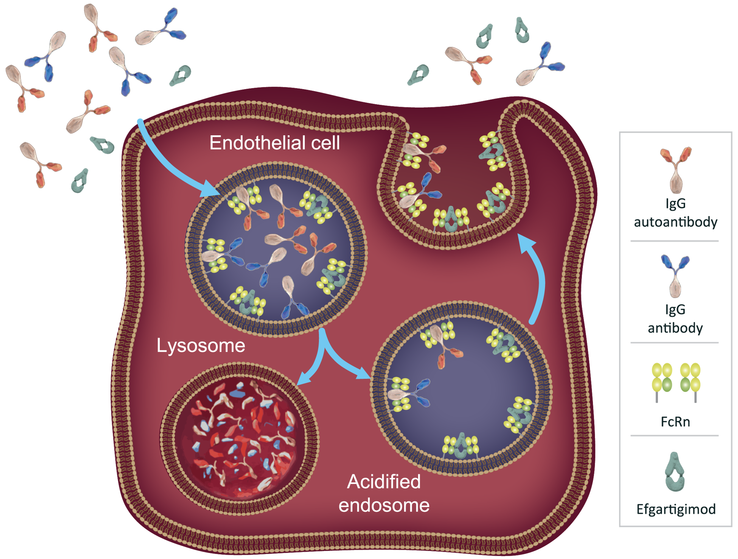
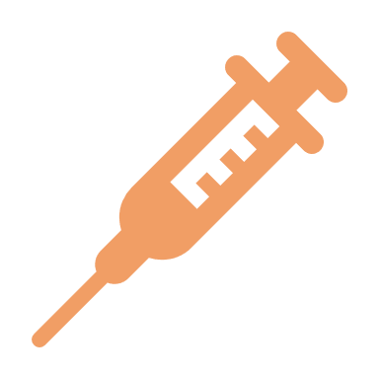
Overview of the Safety Profile From Efgartigimod Clinical Trials in Participants With Diverse IgG-Mediated Autoimmune Diseases
Michelle Sholzberg,¹ Kelly Gwathmey,² Catherine M. Broome,³ Matthias Goebeler,⁴ Hiroyuki Murai,⁵ Zsuzsanna Bata-Csörgo,⁶ Adrian Newland,⁷ Peter Ulrichts,⁸ Rene Kerstens,⁸ Jeffrey T. Guptill,⁸ Sofiane Agha,⁸ Ming Jiang,⁸ James F. Howard Jr⁹
¹Department of Medicine, University of Toronto, Toronto, ON, Canada; ²Department of Neurology, Virginia Commonwealth University, Richmond, VA, USA; ³Department of Medicine, Georgetown University, Washington, DC, USA; ⁴Department of Dermatology, Venereology and Allergology, University Hospital Wϋrzburg, Wϋrzburg, Germany; ⁵Department of Neurology, School of Medicine, International University of Health and Welfare, Narita, Japan; ⁶Department of Dermatology and Allergology, University of Szeged, Szeged, Hungary; ⁷Centre for Haematology, Barts and the London School of Medicine & Dentistry, Queen Mary University of London, London, UK; ⁸argenx, Ghent, Belgium; ⁹Department of Neurology, The University of North Carolina at Chapel Hill, Chapel Hill, NC, USA
BACKGROUND
RESULTS
KEY TAKEAWAYS
Efgartigimod: Engineered IgG1 Fc Fragment^{1–5}
Generalized Myasthenia Gravis
Generalized Myasthenia Gravis OLE
Primary Immune Thrombocytopenia
Primary Immune Thrombocytopenia OLE
EFG reduces IgG levels via FcRn blockade and does not lead to complete removal of IgG, nor does it impact IgG production
The neonatal Fc receptor (FcRn) recycles immunoglobulin G (IgG), extending its half-life and serum concentration¹
Efgartigimod (EFG) is a human IgG1 Fc fragment, a natural ligand of FcRn, engineered for increased affinity for FcRn²
EFG was designed to outcompete endogenous IgG, preventing recycling and promoting lysosomal degradation of IgG, without impacting its production^{2–5}:
Targeted reduction of all IgG subtypes
No impact on other immunoglobulins
No reduction in albumin or increase in cholesterol levels
Phase 3 ADAPT⁴
Phase 3 ADAPT+ OLE
3-year maximum
Phase 3 ADVANCE IV
Phase 3 ADVANCE+ OLE: 4-year maximum
EFG: n=84
Placebo: n=83
EFG: N=151 rolled over from ADAPT; 145 received ≥1 dose
EFG: n=86
Placebo: n=45
EFG: N=101 rolled over from ADVANCE (September 2022)
EFG 10 mg/kg IV
EFG 10 mg/kg IV
EFG 10 mg/kg IV
EFG 10 mg/kg IV
Study duration: up to 26 weeks
Initiation – cycles of 4 weekly infusions
Subsequent cycles administered according to individual clinical response (MG-ADL score) at least 8 weeks from initiation of previous cycle
Study duration and dosing:
Maximum 19 cycles
Subsequent cycles administered according to individual clinical response (MG-ADL score) at least 7 weeks from initiation of previous cycle
Study duration: 24 weeks
Weeks 1–4: weekly dosing
Weeks 4–15: weekly or every-other-week* dosing
Weeks 16–24: continued based on Week 15 dosing
Study duration: 52 weeks (extendable to 3 more 52-week periods)
Dosing either weekly or every other week, continued from ADVANCE IV
Change in dosing frequency permitted from Visit 1
Patients with various IgG-mediated autoimmune disorders demonstrated 60.1–63.5% reduction in total IgG levels when treated with EFG
Concomitant therapy at baseline:
Acetylcholinesterase inhibitors (EFG: 85%; placebo: 81%)
Corticosteroids (EFG: 71%; placebo: 81%)
NSISTs (EFG: 61%; placebo: 61%)
Concomitant therapy at baseline:
Acetylcholinesterase inhibitors (86%)
Corticosteroids (77%)
NSISTs (61%)
Concomitant therapy at baseline:
Corticosteroids (EFG: 26%; placebo: 27%)
TPO-RA (EFG: 23%; placebo: 20%)
NSISTs (EFG: 9%; placebo: 13%)
Danazol (EFG: 2%; placebo: 2%)
Concomitant therapy at baseline:
Corticosteroids (27%)
TPO-RA (22%)
NSISTs (14%)
Image adapted from Kang TH, Jung ST. Boosting therapeutic potency of antibodies by taming Fc domain functions. Exp Mol Med. 2019;51:1–9 and distributed under the terms of the Creative Commons CC-BY license (https://creativecommons.org/ licenses/by/4.0/).
100
EFG 10 mg/kg
100
EFG 10 mg/kg
100
EFG 10 mg/kg
100
EFG 10 mg/kg
EFG was well tolerated with comparable TEAE rates to placebo across multiple IgG-mediated autoimmune disorders
Placebo
Placebo
75
75
75
75
Percentage of Participants, %
Percentage of Participants, %
Infections by Cycle
Percentage of Participants, %
Percentage of Participants, %
50
50
0
50
50
FcRn blockade with EFG does not lead to complete IgG removal^{2,5}
Patients treated with EFG for various IgG-mediated autoimmune disorders showed a mean maximum reduction of 60.1–63.5% in total IgG levels^{4,6–8}
EFG treatment did not lead to any abnormal infection patterns compared with placebo, and most infections were mild to moderate in severity^{4,6–8}
25
25
25
25
Most TEAEs, including infections, were mild to moderate in severity, and incidence rate did not increase with longer exposure
0
0
25
100
0
0
Percentage of Participants, %
Mean Maximum Reduction in Total IgG Levels From Baseline Upon Treatment With EFG
 | Phase 3 ADAPT for gMG |  | Phase 3 ADAPT+ OLE for gMG | Phase 3 ADVANCE IV for Primary ITP |  | Phase 3 ADVANCE+ OLE for Primary ITP
Incidence Rate† | EFG 10 mg/kg IV (n=84) [34.9 PY] | Placebo IV (n=83) [34.5 PY] | EFG 10 mg/kg IV (N=145) [229.0 PY] | EFG 10 mg/kg IV (n=86) [38.0 PY] | Placebo IV (n=45) [19.2 PY] | EFG 10 mg/kg IV (N=101) [69.1 PY]
≥1 TEAE | 7.2 | 7.8 | 3.5 | 13.6 | 17.9 | 8.2
≥1 serious TEAE | 0.1 | 0.3 | 0.2 | 0.3 | 0.4 | 0.3
Severe TEAEs (grade ≥3) | 0.3 | 0.4 | 0.3 | 0.6 | 0.7 | 0.5
Discontinued due to AEs | 0.2 | 0.1 | 0.1 | 0.1 | 0.0 | 0.0
Infection | 1.6 | 1.2 | 0.7 | 1.0 | 0.6 | 0.8
Thromboembolic events | 0.03 | 0.03 | 0.02 | 0.00 | 0.00 | 0.05
50
ADAPT
Phase 3 gMG*
ADVANCE
Phase 3 ITP†
Phase 2
Pemphigus‡
EFG was well tolerated and demonstrated a consistent safety profile across varying dosing regimens and exposure times
n=84
n=64
n=19
n=15
−
Mean Maximum Total IgG
Percentage Change From Baseline, %
EFG 10 mg/kg
EFG 10 mg/kg
EFG 10 mg/kg
EFG 25 mg/kg
Phase 2 Pemphigus Open-Label Study⁶
≥1 treatment-emergent adverse event (TEAE) was reported by 84% of participants receiving EFG 10 mg/kg (n=19) and 87% receiving EFG 25 mg/kg (n=15)
Of the 32 adverse events (AEs) of special interest (infections and infestations), 7 events in 5 participants (15.6%) were considered related to study treatment; none led to study discontinuation, and all were mild to moderate in severity, except 1 case of pneumonia and 1 of tooth infection, both of which were grade 3
No abnormal infection patterns were observed; 2 serious AEs were reported, which were assessed as unrelated to EFG (pneumonia and tibia fracture)
In all studies, EFG treatment did not lead to reductions in albumin or increases in cholesterol levels
EFG did not hamper generation of IgG responses but did transiently reduce IgG titers⁹
Antigen-specific IgG responses to influenza, pneumococcal, and COVID-19 immunization were detected in participants with generalized myasthenia gravis (gMG) who received these vaccines while receiving EFG
−
EFG treatment did not decrease albumin or increase cholesterol levels
−
−61.3
−60.1
−63.2
−63.5
*Measured 1 week after 4th infusion in cycle 1. †Measured in Week 4. ‡Measured on Day 29.
EFG is approved for the treatment of gMG in adult patients positive for anti-acetylcholine receptor antibodies in the US and Europe, and for patients regardless of antibody status in Japan
Presented at the Fall Clinical Dermatology Conference; October 19–22, 2023; Las Vegas, NV, USA
abbreviations and FOOTNOTES
AE, adverse event; C, cycle number; EFG, efgartigimod; FcRn, neonatal Fc receptor; gMG, generalized myasthenia gravis; IgG, immunoglobulin G; ITP, immune thrombocytopenia; IV, intravenous; MG-ADL, Myasthenia Gravis Activities of Daily Living; NSIST, nonsteroidal immunosuppressive therapy; OLE, open-label extension; PY, patient-year(s); TEAE, treatment-emergent adverse event; TPO-RA, thrombopoietin receptor agonist.
*The dosing schedule could change to every other week from Weeks 4–15 in participants who achieved platelet counts of ≥100×10⁹/L for 3 out of 4 consecutive weeks, including the last of these weeks. Treatment could change from every other week to weekly in participants whose platelet counts decreased to <100×10⁹/L for 2 consecutive weeks or <30×10⁹/L for 1 week, or in participants who received rescue therapy. †Incidence rate calculated as number of events per patient-year of follow-up.
DISCLOSURES and acknowledgments
MS: Consultant: Band Therapeutics; Unrestricted research funding: Octapharma, Pfizer; Honoraria: Amgen, Novartis, Octapharma, Pfizer; KG: Consultant: Alexion Pharmaceuticals, argenx BVBA, Strongbridge, UCB; Honoraria: Alexion Pharmaceuticals; CMB: Honoraria: Alexion Pharmaceuticals, Apellis, argenx, Sanofi; MG: Consultant: Almirall, argenx (paid to institution); Honoraria: Biotest, GSK, Janssen, Leo Pharma, Lilly, Novartis, UCB; HM: Consultant: Alexion Pharmaceuticals, argenx, Roche, UCB; Honoraria: Japan Blood Products Organization, Chugai; ZB-C: Consultant: Sanofi-Genzyme Hungary; Honoraria: Orvostovábbképzo Szemle; Research funding: NKFI Hungary; AN: Consultant: Amgen, Angle, argenx, Dova, Novartis, Ono, Rigel, Shionogi; Research funding: Amgen, Novartis, Rigel; Honoraria: Amgen, Angle, argenx, Dova, Novartis, Ono, Rigel, Shionogi; Paid expert testimony: argenx, Rigel; PU, RK, JTG, SA, MJ: Employees of argenx; JFH: Alexion, argenx, Biologix Pharma, Cartesian Therapeutics, Centers for Disease Control and Prevention, F. Hoffman-LaRoche Ltd, Horizon, Merck EMD Serono, Muscular Dystrophy Association, Myasthenia Gravis Foundation of America, NIH (including NINDS and NIAMS), NMD, Novartis, Patient-Centered Outcomes Research Institute, Regeneron, Roche, Sanofi US, Takeda, Toleranzia, UCB, Zai Labs.
REFERENCES
1. Sesarman A, et al. Cell Mol Life Sci. 2010;67:2533–50. 2. Ulrichts P, et al. J Clin Invest. 2018;128:4372–86. 3. Vaccaro C, et al. Nat Biotech. 2005;23:1283–8. 4. Howard JF Jr, et al. Lancet Neurol. 2021;20:526–36. 5. Nixon AE, et al. Front Immunol. 2015;6:176. 6. Goebeler M, et al. Br J Dermatol. 2022;186:429–39. 7. Newland AC, et al. Am J Hematol. 2020;95:178–87. 8. Broome CM, et al. Presented at the 64th ASH Annual Meeting and Exposition; December 10–13, 2022; New Orleans, LA. 9. Guptill JT, et al. Autoimmunity. 2022;55:620–31.

