Slide 1

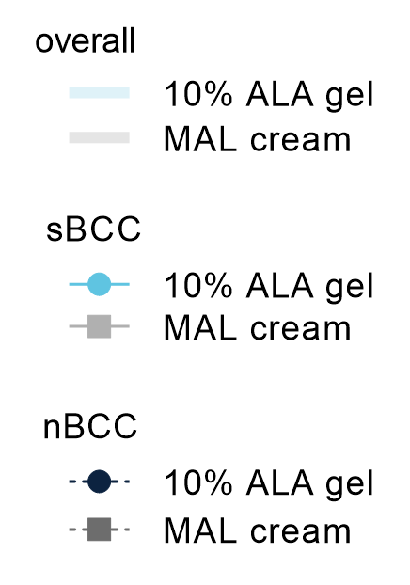
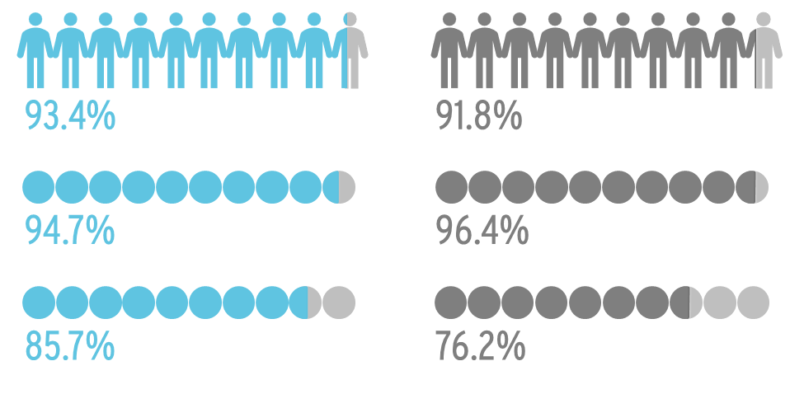


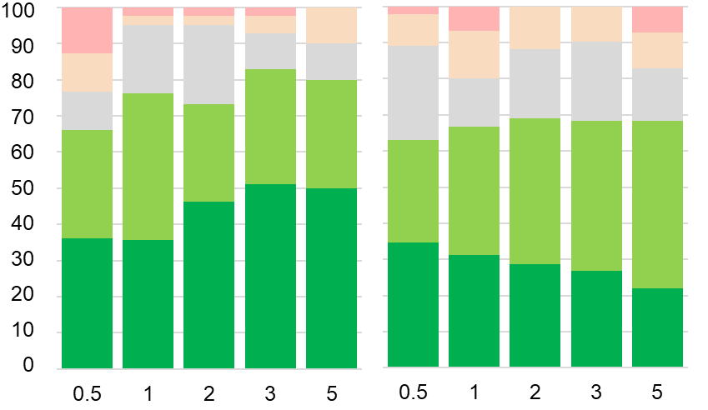



PHOTODYNAMIC THERAPY WITH 10% AMINOLEVULINIC ACID GEL AND RED-LIGHT FOR THE TREATMENT OF NON-AGGRESSIVE BCCs:
5-YEAR FOLLOW-UP DATA OF A RANDOMIZED, CONTROLLED, COMPARATIVE, MULTICENTER PHASE-III-TRIAL
Colin A. Morton ¹, Rolf-Markus Szeimies ², members of the ALA-BCC-CT008 study-team, Dr. Beate Schmitz ³, Dr. Hermann Luebbert ³*
¹ Dermatology Department, Stirling Community Hospital, Stirling, U.K.; ² Department of Dermatology & Allergology, Klinikum Vest Academic Teaching Hospital, Recklinghausen, Germany; ³ Biofrontera Bioscience GmbH, Leverkusen, Germany * Currently: Biofrontera Inc., Woburn, U.S.
RESULTS
STUDY DESIGN
1
High patient clearance rates 12 weeks after last PDT ^{1, 2}
3
High probability and sustainability of lesion clearance
SYNOPSIS
Basal cell carcinoma (BCC) is the most prevalent skin cancer. While excision is the treatment of choice, scarring can have major cosmetic implications. Photodynamic therapy (PDT) is an alternative, non-invasive, treatment option for BCC that combines both good efficacy and good cosmetic outcome. Long-term efficacy data beyond 12 months post-treatment of BCC lesions with PDT are scarce. This study presents the 5-year follow-up data of a randomized, positive-controlled, observer-blind, phase-III-trial conducted in Germany and the UK from 2014 to 2020, assessing efficacy and safety of red-light PDT in the treatment of non-aggressive BCCs (NCT02144077).
OBJECTIVE
The aim of this study was to assess the safety and efficacy of red-light PDT with 10% aminolevulinic acid (ALA; 78 mg/g) gel as compared to 16% methyl-aminolevulinate (MAL, 160 mg/m) cream in the treatment of thin non-aggressive BCCs.
METHODS
Randomized, observer-blind, comparator-controlled, interindividual, non-inferiority Phase III study was performed at 24 sites in U.K. & Germany
281 adult patients with 1-3 primary nodular or superficial BCCs with up to 2 mm thickness on face/scalp, neck/trunk or extremities were randomized (1:1)
Illumination was performed 3 h after drug application for 10 min with a narrowband red-light source (~635 nm, 37 J/cm²)
Two PDT sessions were performed one week apart (first PDT cycle)
Lesions were assessed 12 weeks after last PDT and retreated in case of remaining lesions with a second PDT cycle.
Follow-up (FU): 6-60 months
ENDPOINTS (FOLLOW-UP)
Patient & lesion recurrence rate during FU, after 12-week clearance post last PDT
Cosmetic outcome, skin quality and patient satisfaction
10% ALA gel
MAL cream
Patient complete clearance rate
93.4%
91.8%
Probability and sustainability
of lesion clearance (%)
Clearance rate of superficial BCC (sBCC)
94.7%
96.4%
Clearance rate of nodular BCC (nBCC)
85.7%
76.2%
follow-up (years)
?
Tendency of 10% ALA gel to be more effective for nBCC compared to MAL cream. Possibly due to better skin penetration? ^{2,3}
Higher probability and sustainability of lesion clearance with sBCC than nBCC
Note: subgroup for nBCC was smaller
2
High sustained patient clearance 5 years after last PDT ⁴
4
Majority of patients had Very Good or Good cosmetic outcome
10% ALA gel
MAL cream
10% ALA gel
10% ALA gel
MAL cream
impaired
MAL cream
unsatisfactory
A higher proportion of male patients had recurrent lesions compared to female patients.
To be considered: Proportion of male patients in 10% ALA gel arm (68.7%) was higher than in the MAL cream arm (47.9%).
satisfactory
Patients
good
Patients still cleared after 5 years (%)
very good
follow-up (years)
Over the course of the follow-up, rating very good increased after PDT with 10% ALA gel but decreased after PDT with MAL cream.
overall
female
male
CONCLUSION
Patient clearance remained high 5 years after the last PDT
Probability and sustainability of lesion clearance remained high throughout the entire follow-up
PDT is an effective and sustainable treatment option for BCCs, and is under further investigation in a US phase-III-trial (NCT03573401)
ALA-BCC-CT008
REFERENCES: ¹ Ameluz SmPC; ² Morton et al., Br J Dermatol. 2018 Aug;179(2):309-319; ³ Maisch et al., Exp Dermatol. 2010 Aug;19(8):e302-5; ⁴ clinicaltrials.gov/study/NCT02144077
This study was sponsored by Biofrontera Bioscience GmbH.

