Slide 1
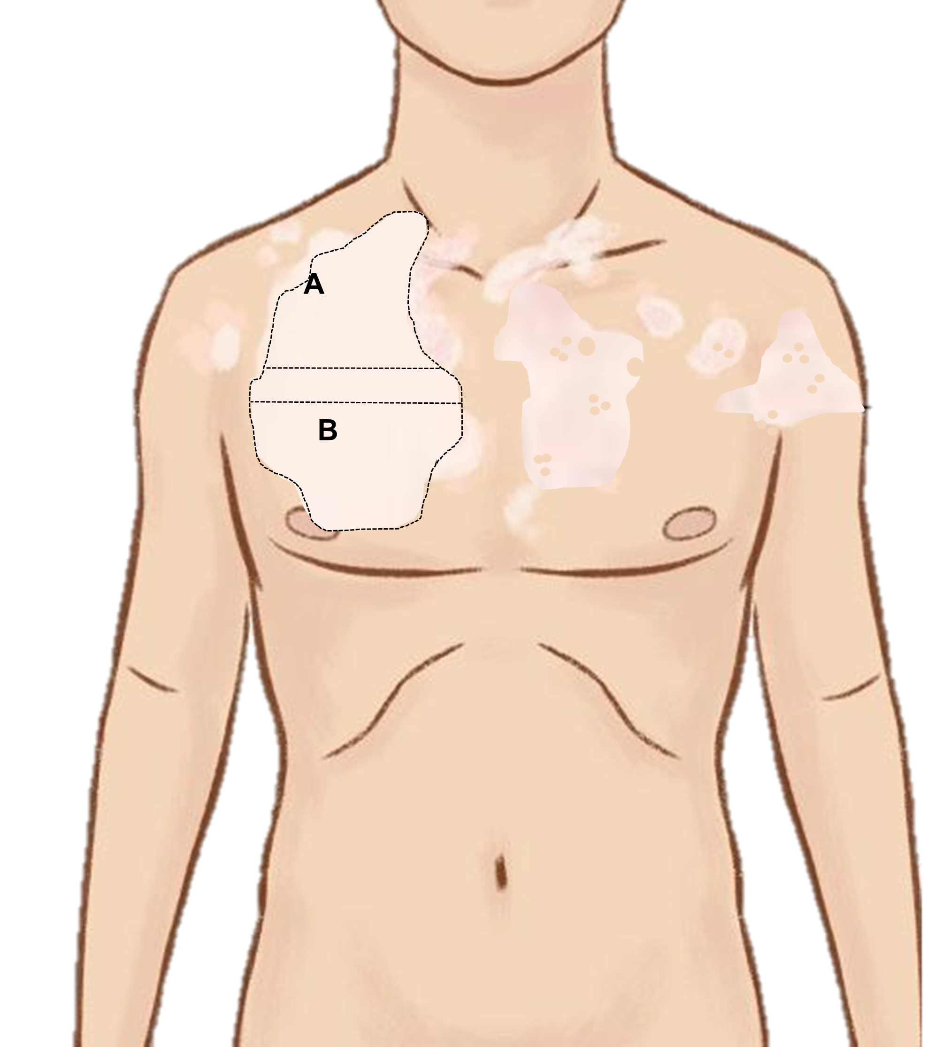
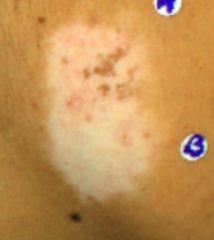
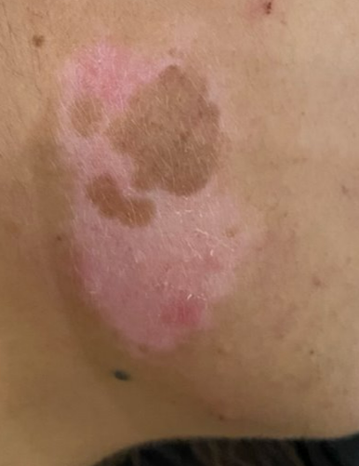
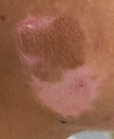
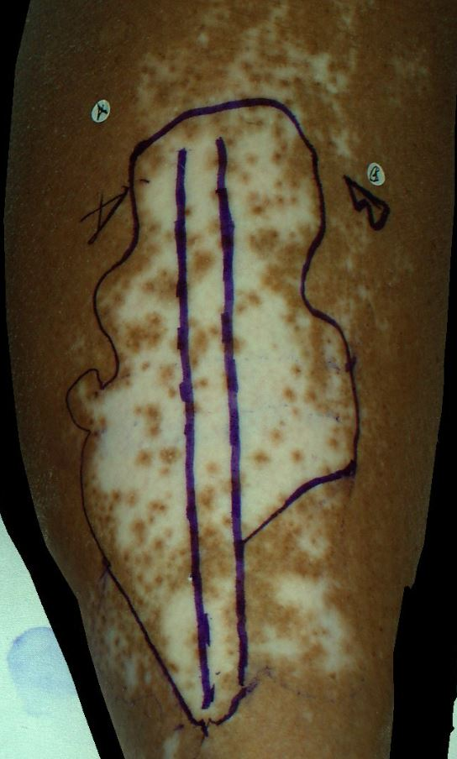
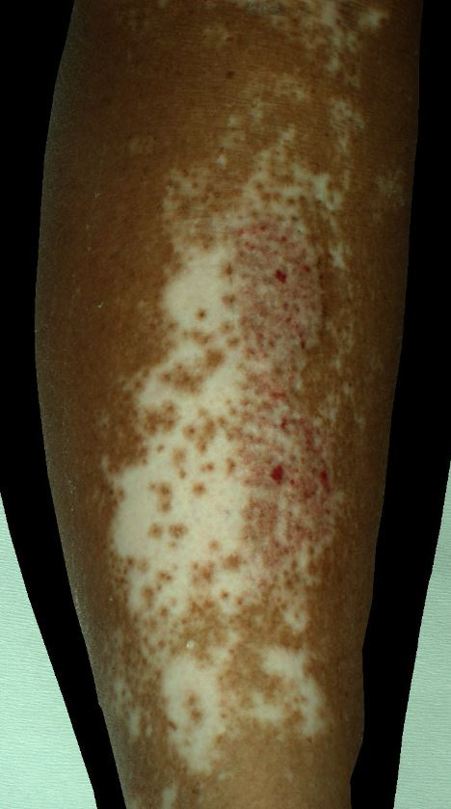
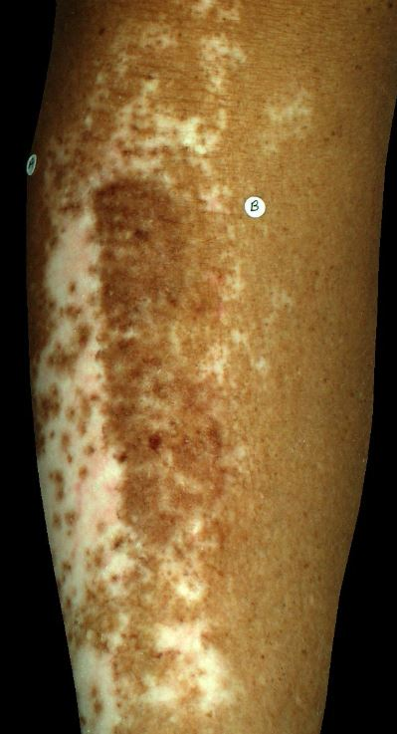
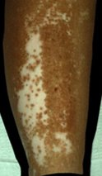
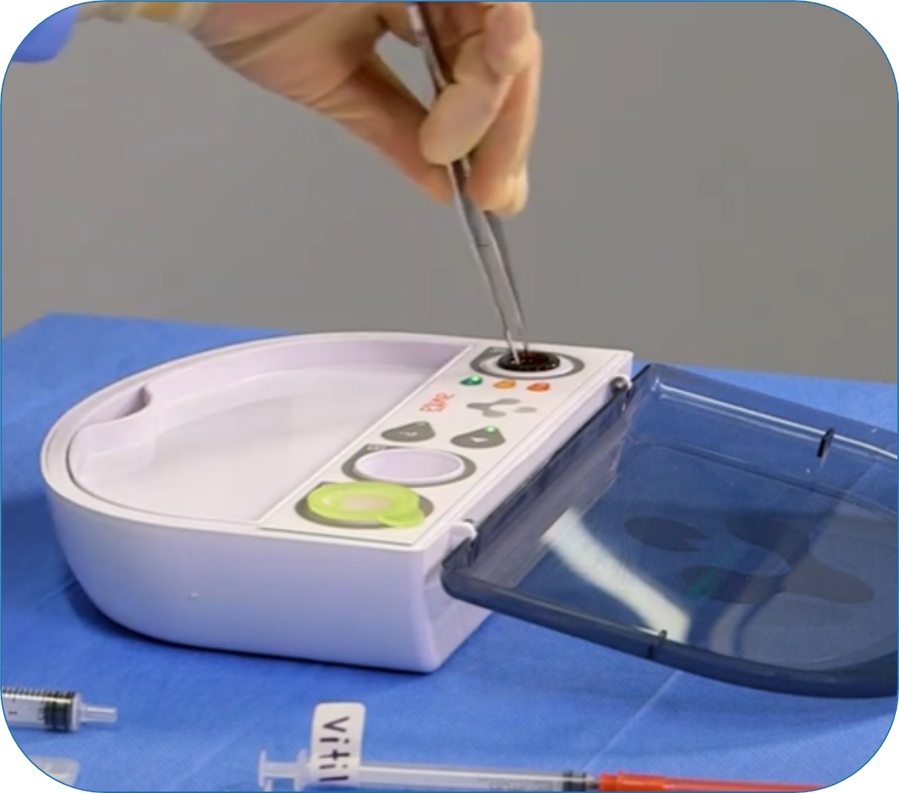
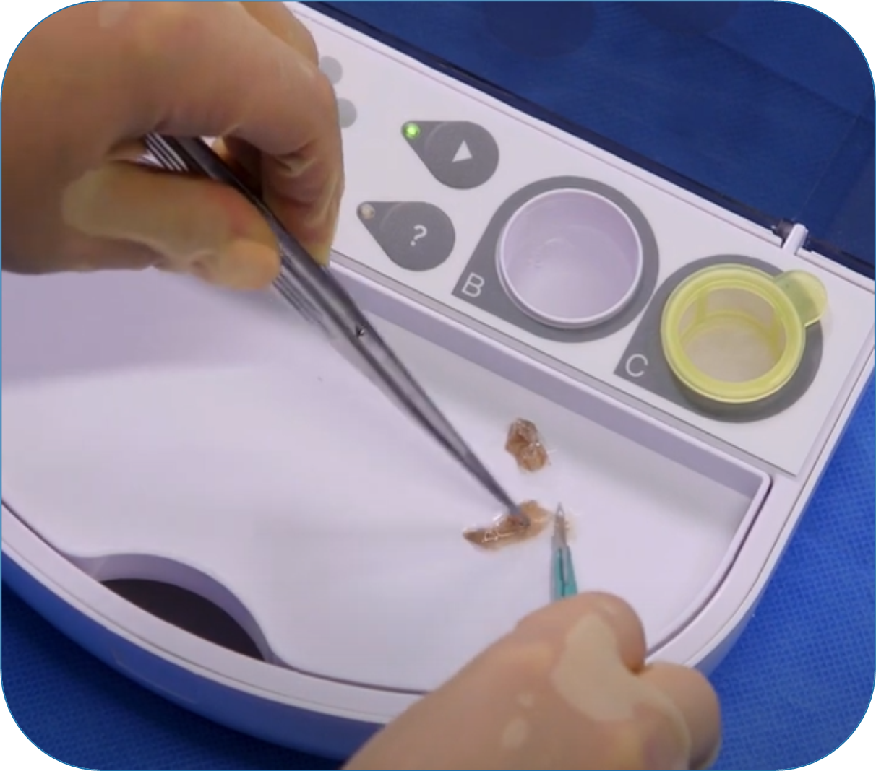
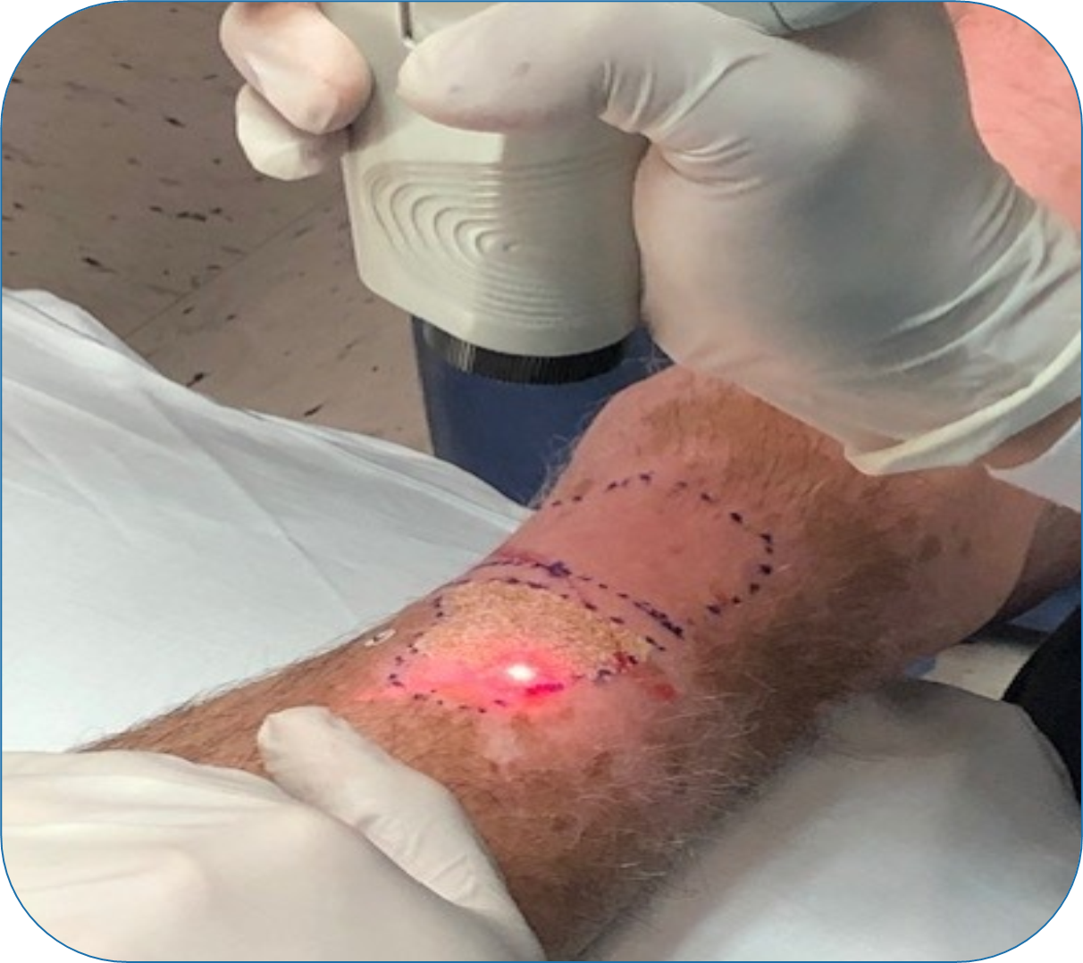
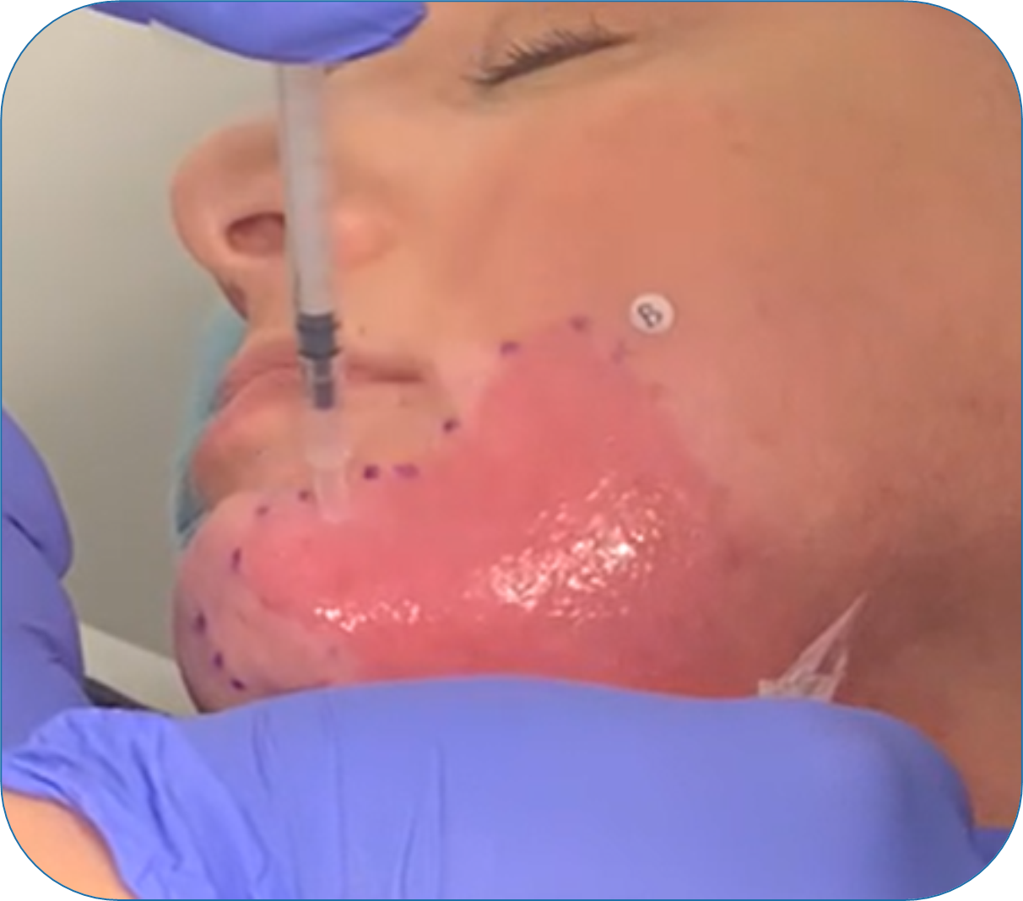
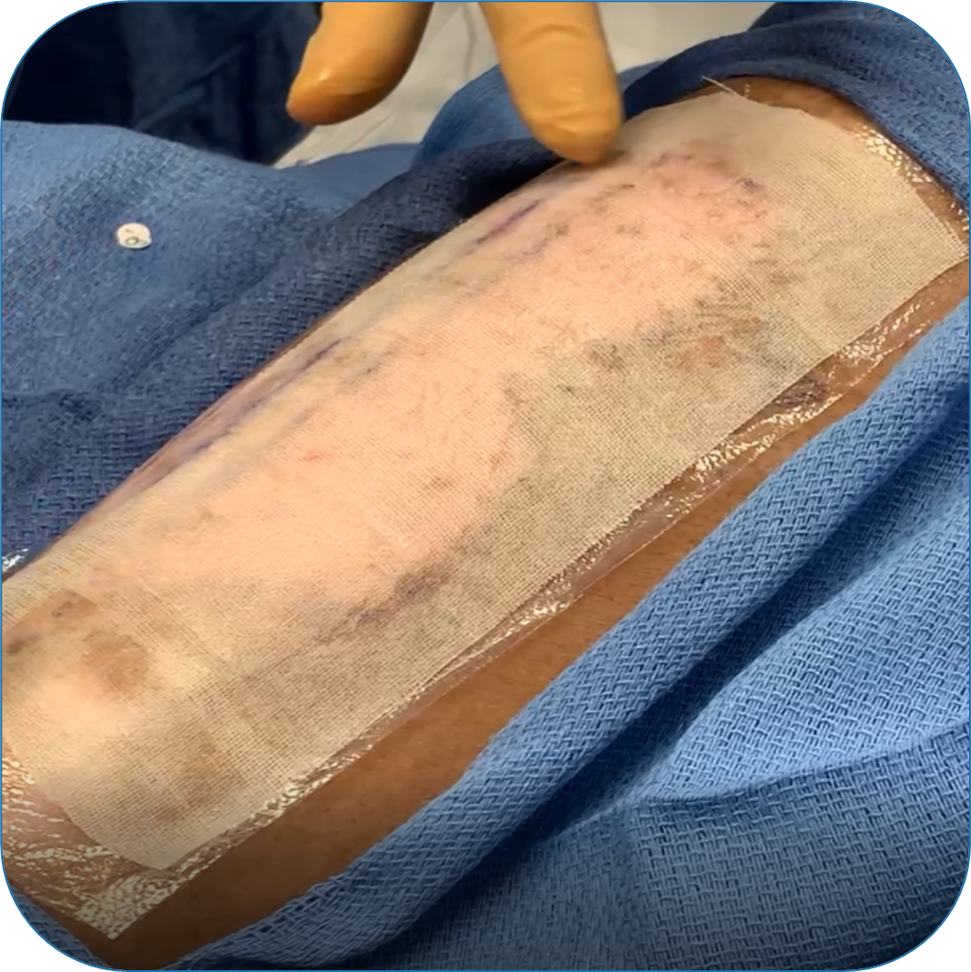
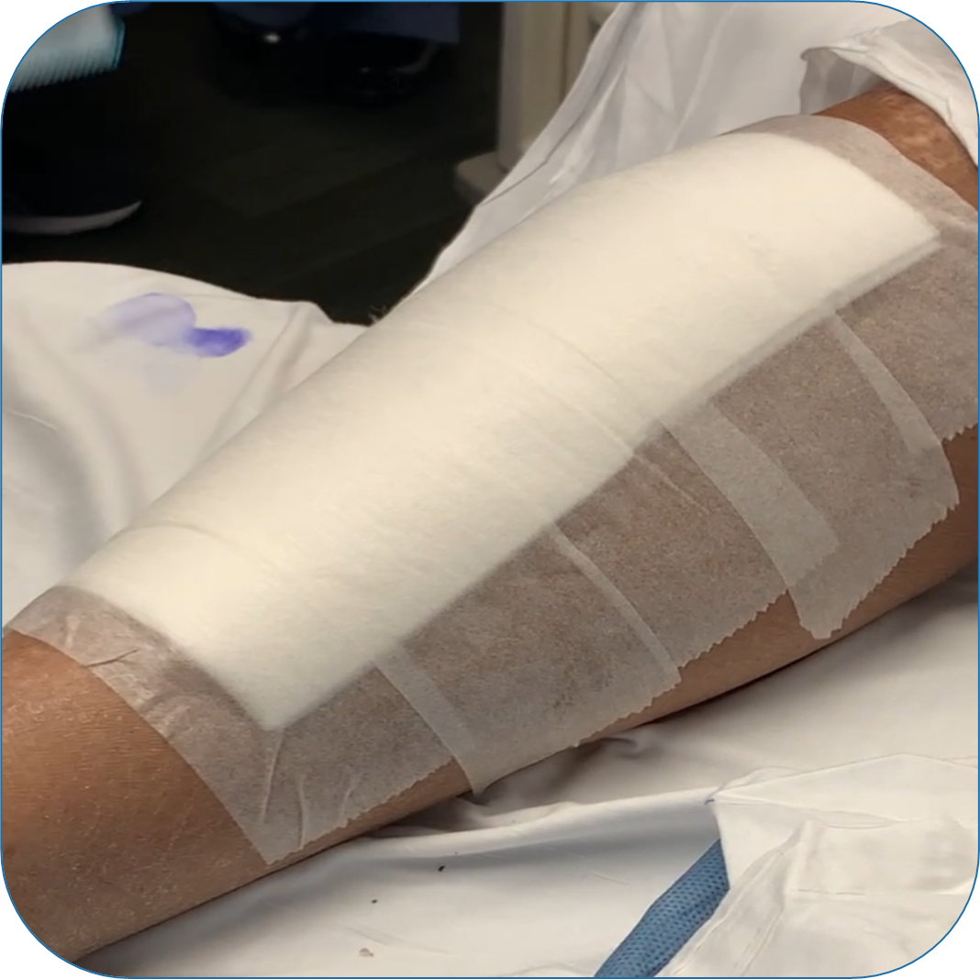
Early repigmentation of stable vitiligo through point-of-care melanocyte transfer using non-cultured autologous skin cell suspension
Iltefat Hamzavi, MD, Henry Ford Health System & RSVP Study Working Group
RSVP Study Working Group: Ammar Ahmed, MD, Alpesh Desai, DO, Anand Ganesan, MD, PhD, Mitchel Goldman, MD,
Victor Huang, MD, Steven Kahn, MD, Bassel Mahmoud, MD, PhD, FAAD, Gilly Munavalli, MD, MHS, FAAD, FACMS, Deanne Robinson, MD, FAAD, Jill Waibel, MD, Eduardo Weiss, MD, FAAD
BACKGROUND
RESULTS
Vitiligo affects up to 2% of the world’s population
Surgical treatment (cellular or tissue grafting) is indicated for stable vitiligo
There are challenges with current surgical treatments, including 1:1 expansion ratio, time to culture, and/or requirement for specialized equipment and expertise
Autologous skin cell suspension (ASCS) can be prepared in 30 minutes by a dermatologist using a point-of-care autologous cell harvesting device (ACHD) with a 1:20 donor skin to treatment ratio
Repigmentation at Week 24
Early Repigmentation
(≥26% repigmentation)
P < 0.025
Super-superiority Established at Week 24
METHODS
Study Design & Objective
This randomized, within-subject controlled study evaluated the application of autologous skin cell suspension (ASCS) for the safe and effective repigmentation of stable vitiligo lesions
Treatment Group
Laser Ablation
+ ASCS (1:20)
+ NB-UBV
Case Example #1: Focal Vitiligo | Stable 5 Years | Location: Face | Lesion Area: 4cm²
CONCLUSION
Control Group
NB-UVB alone
Post Laser Ablation
4 Weeks Post-ASCS
12 Weeks Post-ASCS
24 Weeks Post-ASCS
ASCS
Significantly more ASCS-treated lesions resulted in ≥80% repigmentation at Week 24 compared to control
Repigmentation can be seen as early as 4 weeks
ASCS is a safe and effective treatment strategy for the transfer of viable melanocytes, keratinocytes, and fibroblasts for stable vitiligo lesions.
Primary Effectiveness Endpoint
Key Inclusion Criteria
Proportion of vitiligo lesions achieving ≥80% repigmentation for ASCS-treated areas vs. control areas at Week 24
Evaluated by a blinded Central Review Committee
<30% BSA, Stable ≥12 months
No topicals or phototherapy within past 90
days
Unsatisfactory response to previous treatment
of topicals and phototherapy
Control
PROCEDURAL STEPS
Case Example #2: Generalized Vitiligo | Stable 4 Years | Location: Shin | Lesion Area: 82.5cm²
1. Obtain Skin Sample
2. Prepare Cell Suspension
3. Ablate Lesion & Apply Cell Suspension
4. Dressings & Aftercare
Pre-Treatment
4 Weeks Post-ASCS
12 Weeks Post-ASCS
24 Weeks Post-ASCS
REFERENCES
Apply local anesthetic and obtain thin skin sample using a tool familiar to the dermatologist
Subject skin sample to enzymatic and mechanical processing using the ACHD device
ASCS
Prepare treatment area with epidermal ablation, then apply cell suspension
Apply dressings. Protect from trauma & moisture for 5-7 days.
1. Kruger C, et al. International Journal of Dermatology. (2012) 51, 1206-1212.
2. Daniel B, et al. Australasian Journal of Dermatology. (2012) 56, 85-92.
3. Baidya S, et al. Ind Psychiatry J. 2021 Jan-Jun;30(1):62-66.
4. Fatima S, et al. Int J Dermatol. 2023 Mar;62(3):279-289.
Control

