Slide 1
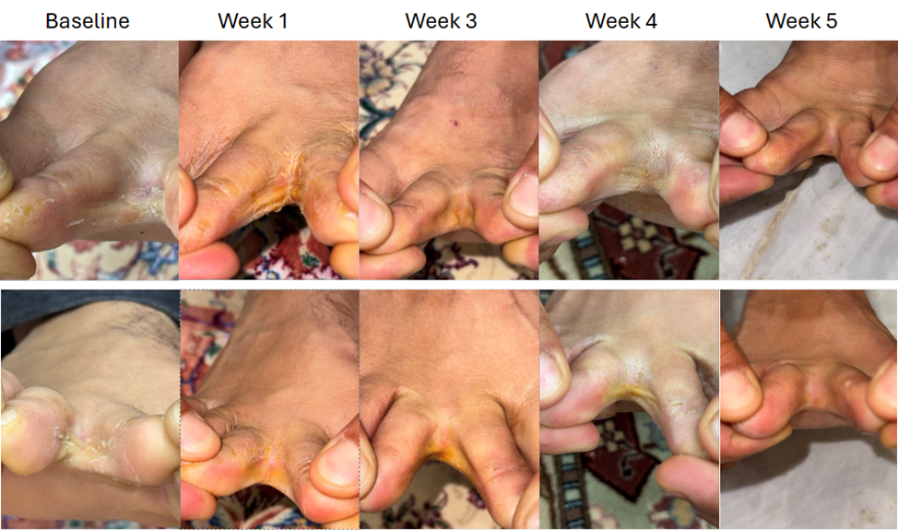
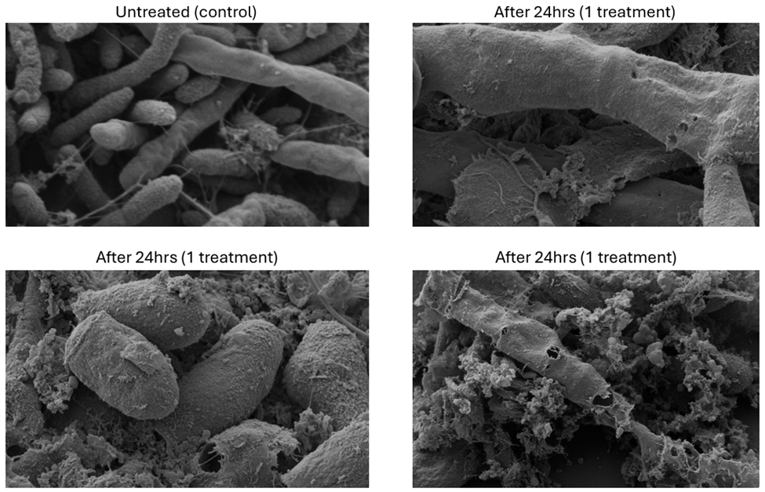
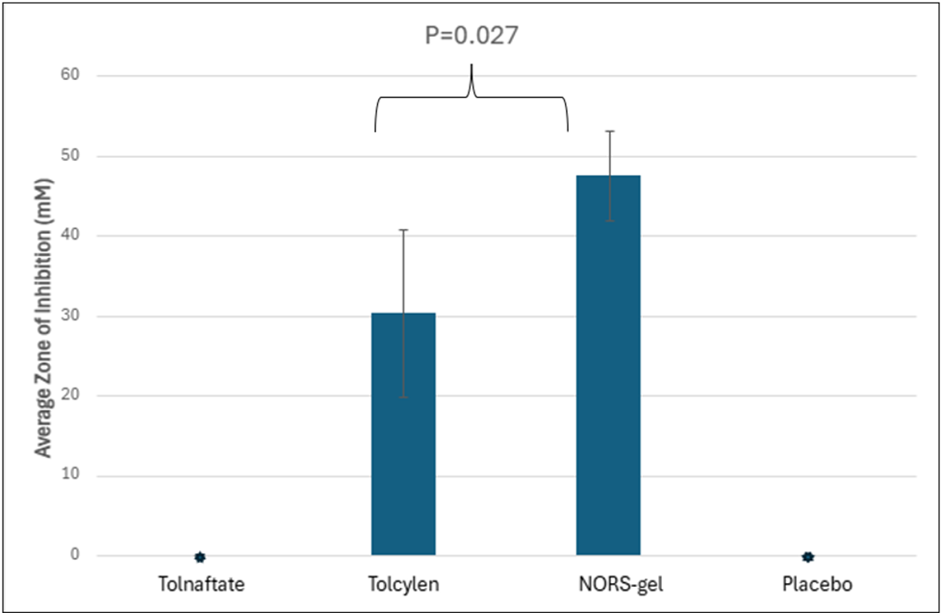
Successful In Vitro and In Vivo Treatment of Tinea Pedis with a Nitric Oxide-releasing Gel
Kaur H, Dorafshanian N, Martins J, Teskey SJL, Miller CC
SaNOtize Research & Development Corp, Vancouver, British Columbia, Canada
Synopsis
Methods
Results
Conclusions
Tinea pedis (athlete’s foot) accounts for nearly half of all superficial fungal infections in adults and remains the most common dermatophyte infection worldwide. The primary etiologic agents, Trichophyton rubrum and Trichophyton mentagrophytes, colonize the stratum corneum by secreting keratinases, with microtrauma, maceration, and hyperkeratosis further promoting invasion and persistence. Management is often complicated by increasing resistance to standard antifungal therapies, the presence of biofilms, and high rates of recurrence. Inadequately treated tinea pedis often progresses to onychomycosis and poses a risk for secondary bacterial infections. These issues underscore the need for alternative strategies with improved efficacy profiles and reduced potential for resistance development.
Nitric oxide (NO) is a potent broad-spectrum antimicrobial with biofilm dispersal activity and a favorable safety profile. NO damages nucleic acids and proteins, disrupts membranes, and blocks key enzymatic processes, inhibiting multiple fungal survival pathways. Unlike single-target ergosterol pathway inhibitors, the polypharmacology of NO decreases the likelihood of classic on-target resistance. Early studies with nitric oxide–releasing solutions (NORS) demonstrated fungicidal efficacy in keratin-rich environments but were constrained by treatment logistics. This study evaluates a novel nitric oxide releasing gel (NORS-gel) designed for practical patient use.
Scanning Electron Microscopy (SEM)
T. rubrum was exposed to NORS-gel across synthetic dermal membranes in a Franz diffusion cell setup. Post-24-hour exposure, samples were processed with glutaraldehyde fixation and subsequently analyzed.
Zone of Inhibition Assay
Synthetic dermal membranes (Strat-M, Millipore) simulating human dermal tissue assessed penetration. 10⁶ CFU/mL of T. rubrum and T. mentagrophytes were plated on SDA. Dermal membranes were centrally positioned and treated with antifungal agents (NORS-gel, Tolcylen, Tolnaftate, or Placebo). Plates underwent incubation at 23-27°C, with daily antifungal reapplication over four days, followed by an additional four-day incubation period. The experiment was conducted in quadruplicate with two technical replicates.
Case Study
A 37-year-old male with refractory tinea pedis applied NORS-gel twice daily for 1 week followed by once daily for 4 weeks. Clinical assessments and patient-reported outcomes documented treatment efficacy and tolerability.
Scanning Electron Microscopy
Untreated cells showed abundant hyphae and intact fungal envelopes. Treatment with NORS-gel impaired hyphae formation, disrupted surface morphology, and caused visible perforations of fungal cell walls (Figure 1). Additionally, extensive fungal cell lysis was observed, conclusively demonstrating that NORS-gel acts as a fungicidal rather than merely fungistatic agent.
NORS-gel penetrates dermal membrane and retains fungicidal efficacy
Both T. rubrum and T. mentagrophytes were highly susceptible to the NORS-gel, thereby demonstrating that the NORS-gel effectively penetrated the synthetic dermal membrane without loss of antifungal action (Figure 2). NORS-gel averaged a 57% greater antifungal effect compared to Tolcylen, with mean zones of inhibition measured to be 47.6mm (SD±5.6mm) and 30.3mm (SD±10.5mm), respectively. Tolnaftate was unable to penetrate the dermal barrier and failed to produce any zone of inhibition.
Case Study Results
The NORS-gel was well tolerated throughout the treatment period. Significant clinical improvement was noted within three weeks of treatment initiation, as demonstrated by photographic documentation (Figure 3).
NORS-gel demonstrated potent fungicidal activity, superior dermal penetration, and encouraging clinical outcomes. Nitric oxide’s multifaceted antimicrobial mechanism may reduce risk of resistance development and confer added benefits in wound healing. While these findings are preliminary, they highlight the therapeutic potential of NORS-gel as a novel topical antifungal agent. These findings warrant further validation in larger randomized studies
Objective
Figure 3. Toe web photos of case study participant at baseline and week 1, 3, 4, 5 treatments. Top row is the left foot between the second and third toes. Bottom row is the right foot between the second and third toes.
Objectives
Financial Disclosure
To investigate the antifungal efficacy, dermal penetration, mechanism of action, and preliminary clinical performance of NORS-gel in refractory tinea pedis.
Kaur, Dorafshanian, Martins, Teskey, and Miller are employees of SaNOtize Research & Development Corporation.
Figure 1. Representative images from SEM study
Figure 2. Zone of Inhibition Assays Using Synthetic Dermal Membranes
Corresponding author: Chris Miller, chris@sanotize.com

